Slide 1

.
Ppt presentation

Slide 2
HTML TEXTS AND HEADINGS

Slide 3
Introduction to HTML
HTML stands for HyperText Markup Language.It is used to design web pages using a Markup Language.
HTML is the combination of Hyper text and Markup Language.
.

Slide 4


Slide 5
HTML TEXTS
The Text Tag Group is a group of tags that are used to create well-formatted text documents.
Text tags include <h1>-<h6>, <p>, <br>, <span>, <b>, <sup>, and others.
HTML contains several elements for defining text with a special meaning. ... Formatting elements were designed to display special types of text

Slide 6
HTML Formatting Elements
Formatting elements were designed to display special types of text:
<b> - Bold text
<strong> - Important text
<i> - Italic text
<em> - Emphasized text
<mark> - Marked text
<small> - Smaller text
<del> - Deleted text
<ins> - Inserted text
<sub> - Subscript text
<sup> - Superscript text

Slide 7
Example for Text
<!DOCTYPE html>
<html>
<body>
<p>This text is normal.</p>
<p><b>This text is bold.</b></p>
</body>
</html>

Slide 8
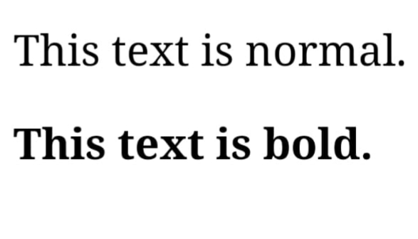
Output

Slide 9
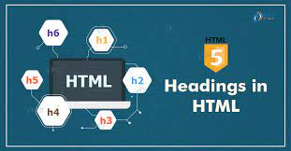

Slide 10
HTML HEADINGS
HTML defines six levels of headings. A heading element implies all the font changes, paragraph breaks before and after, and any white space necessary to render the heading. The heading elements are H1, H2, H3, H4, H5, and H6 with H1 being the highest (or most important) level and H6 the least.
HTML headings are titles or subtitles that you want to display on a webpage.

Slide 11
Example for Heading
<!DOCTYPE html>
<html>
<body>
<h1>Heading 1</h1>
<h2>Heading 2</h2>
<h3>Heading 3</h3>
<h4>Heading 4</h4>
<h5>Heading 5</h5>
<h6>Heading 6</h6>
</body>
</html>

Slide 12
Output Heading 1 Heading 2 Heading 3 Heading 4 Heading 5 Heading 6

Slide 13



Slide 14


Slide 15
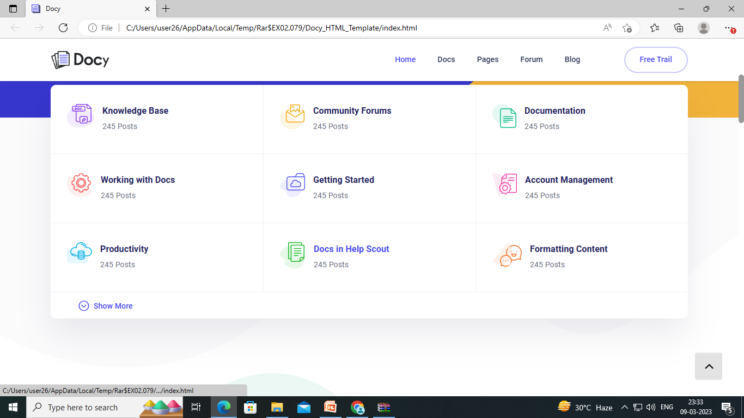
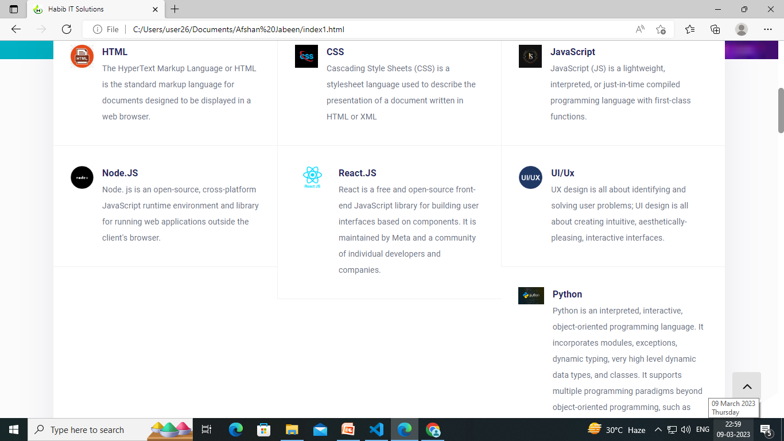

Slide 16
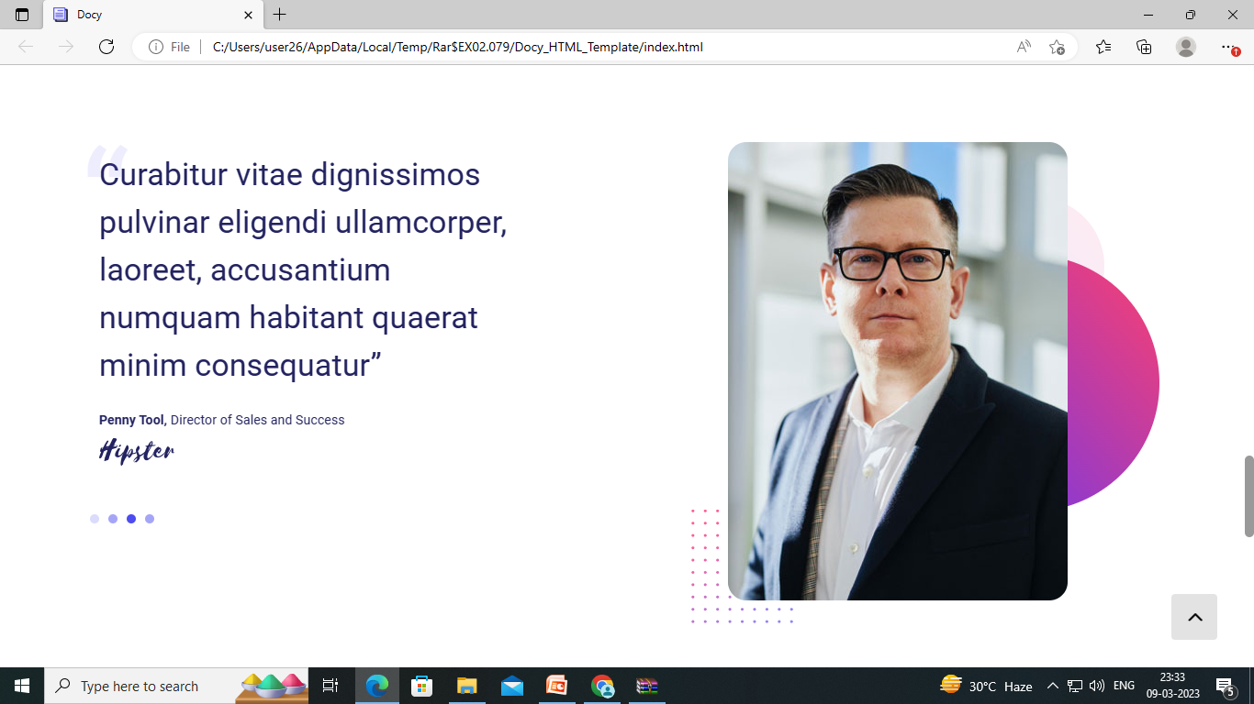

Slide 17
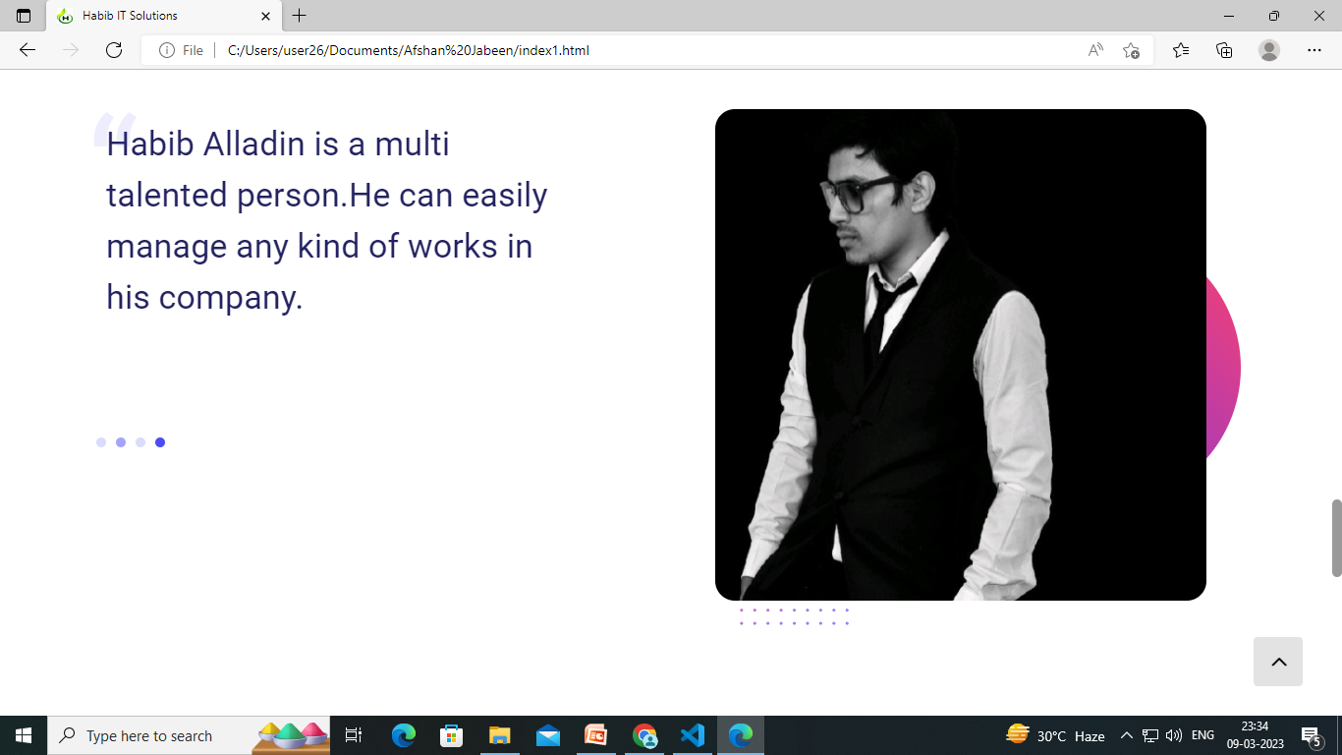

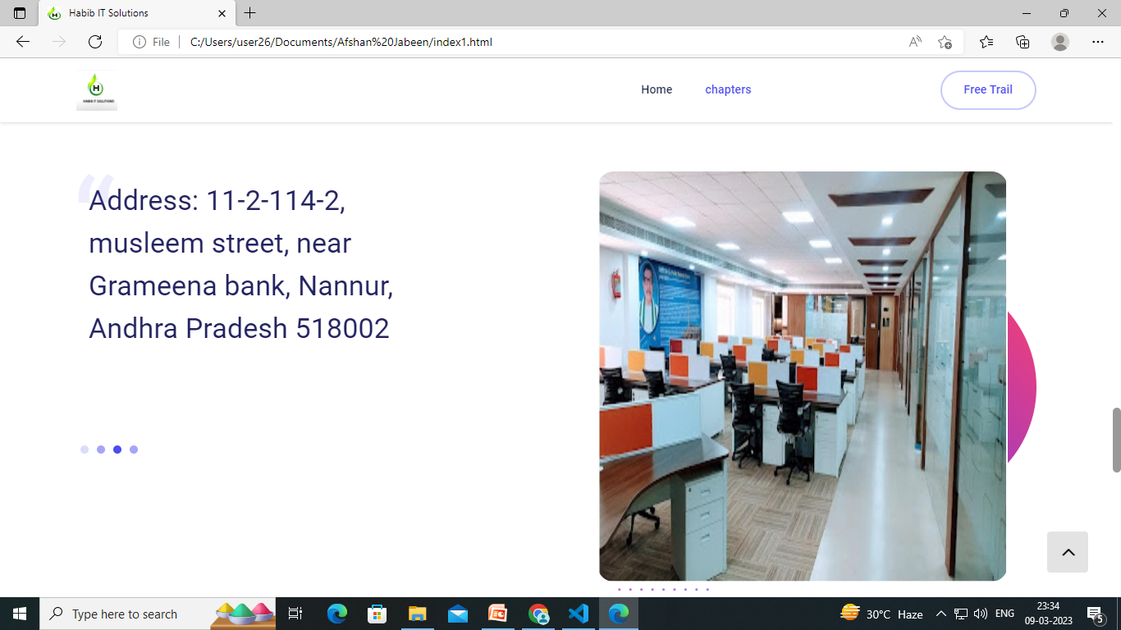


Slide 18
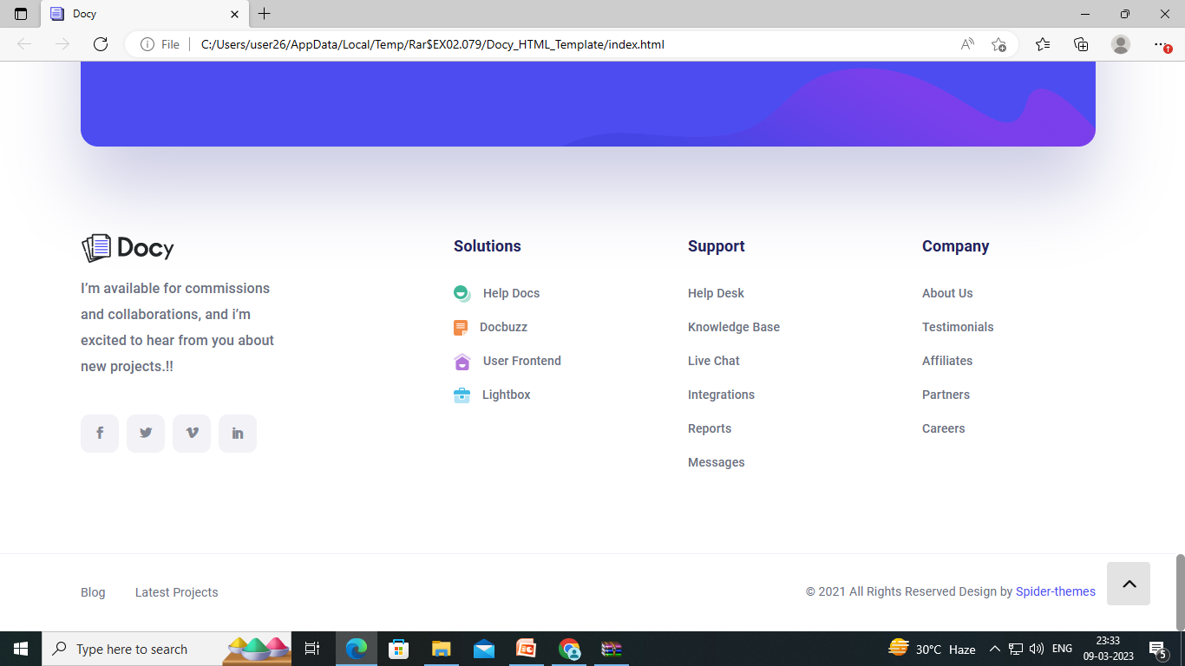
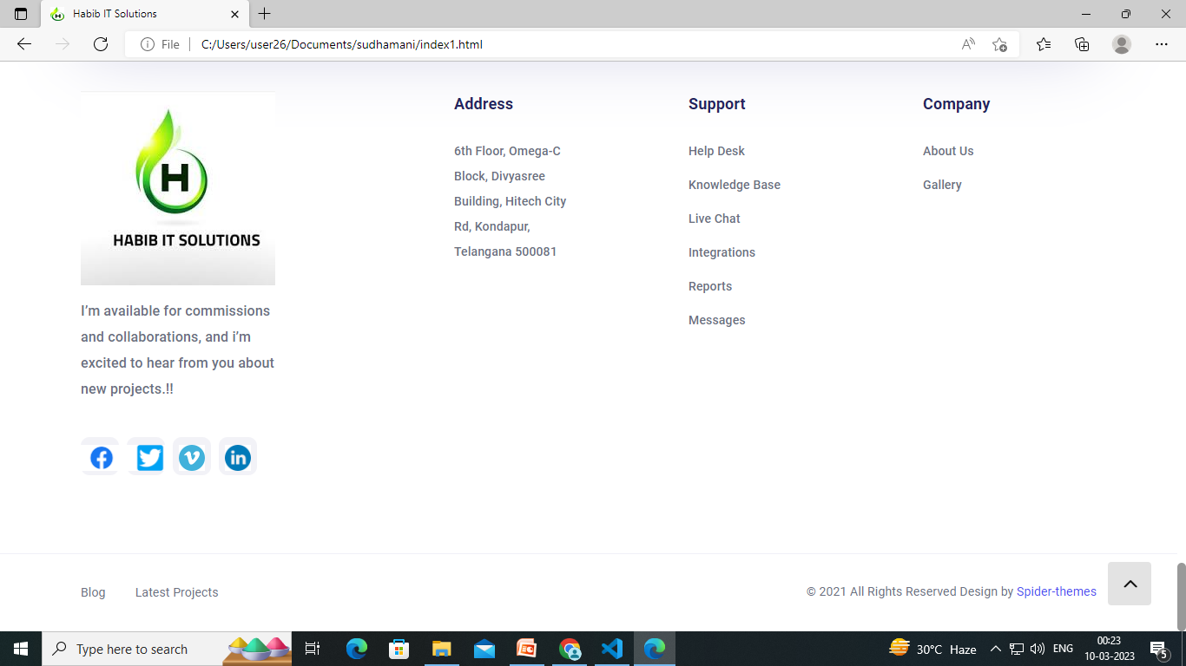

Slide 19
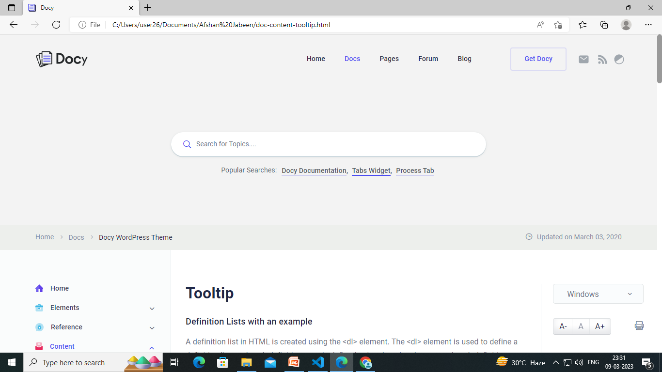
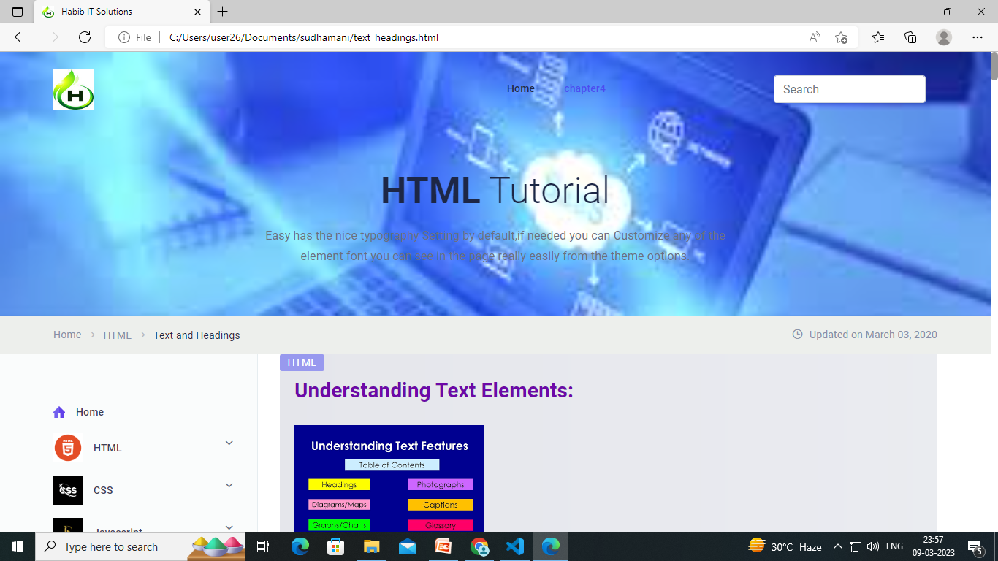

Slide 20
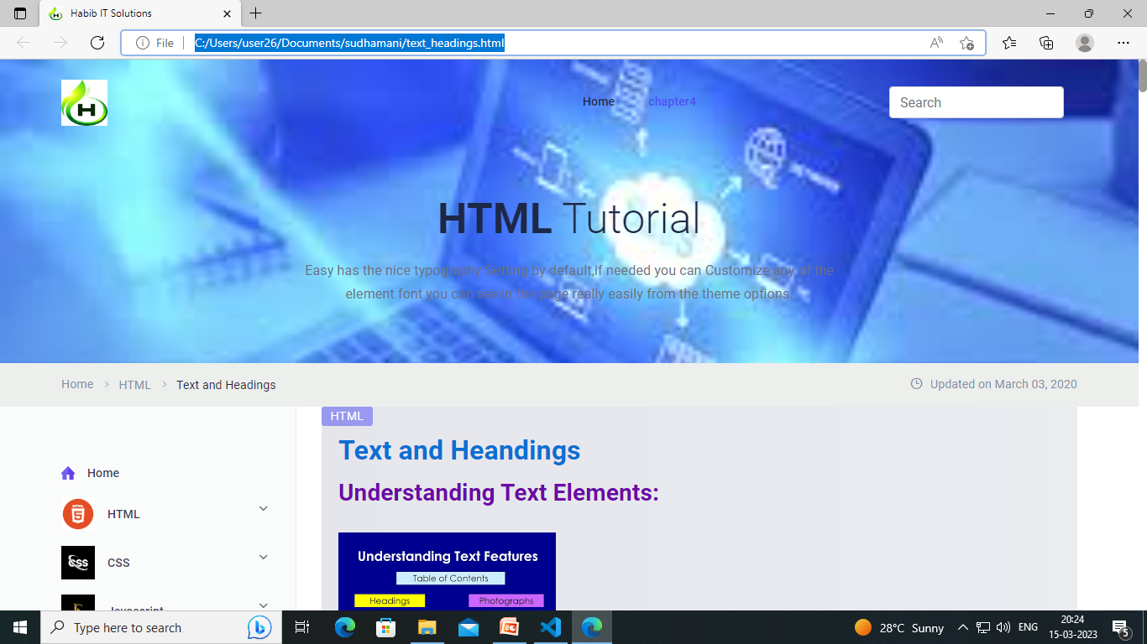

Slide 21
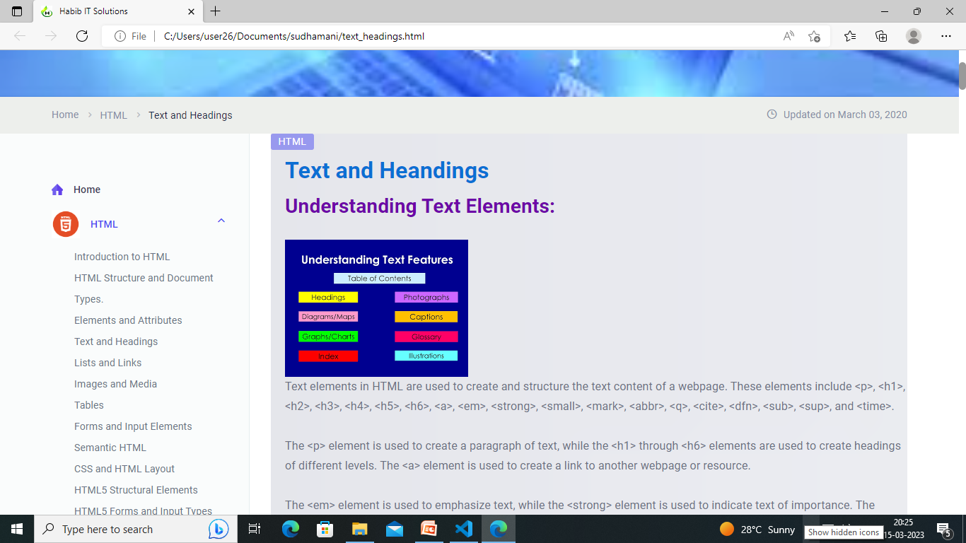

Slide 22
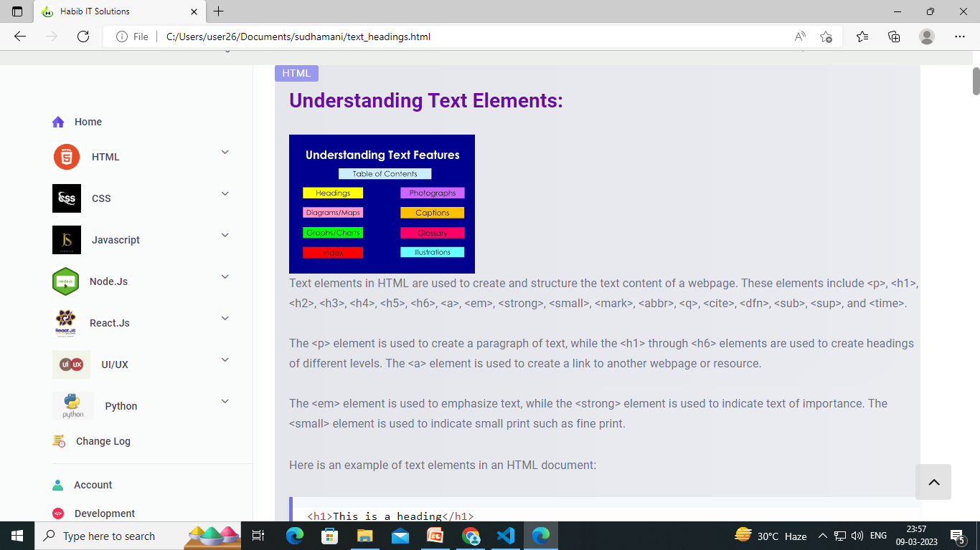

Slide 23
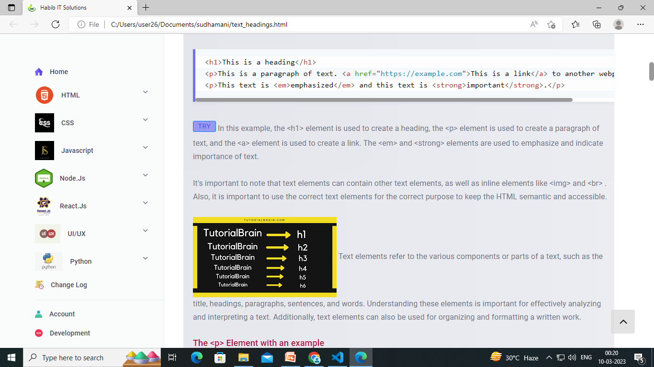

Slide 24
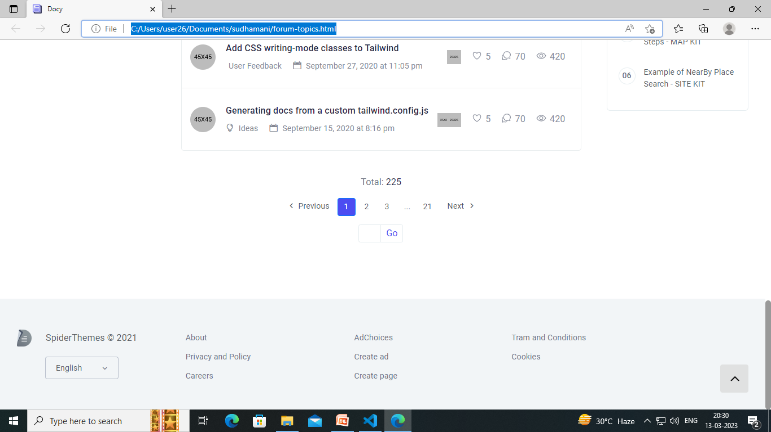
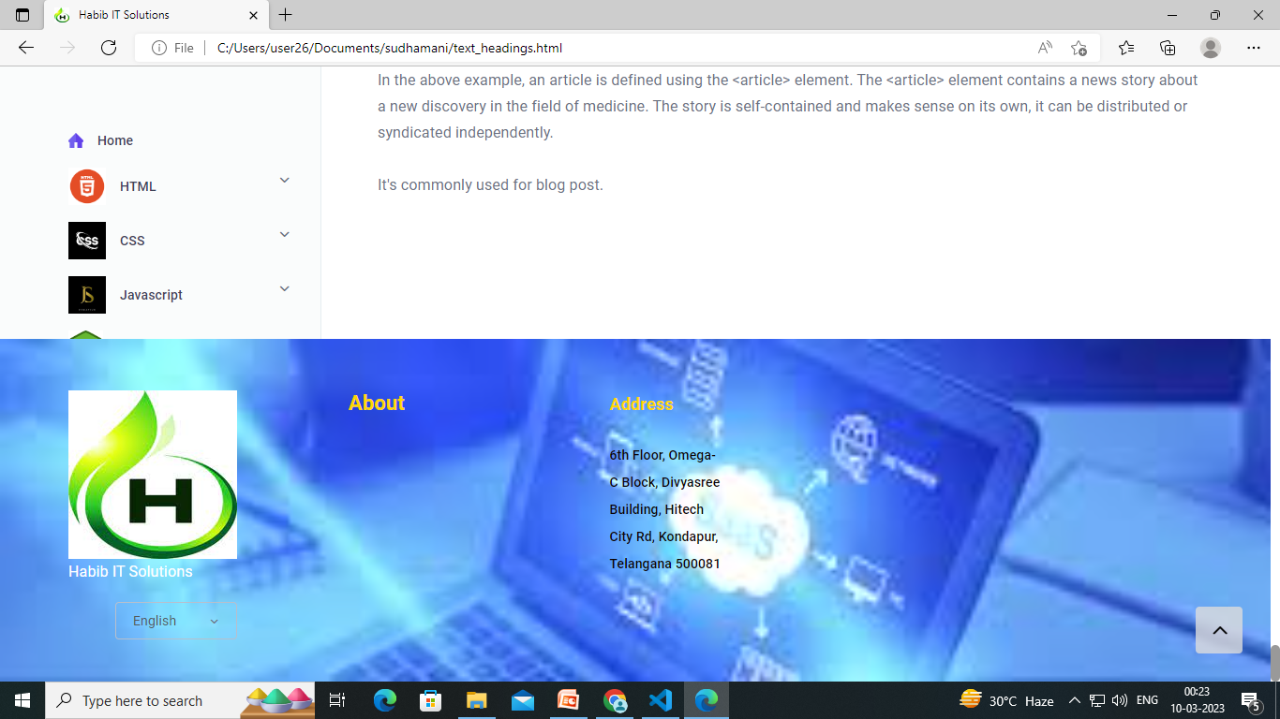

Slide 25


Slide 26


